Slide 1
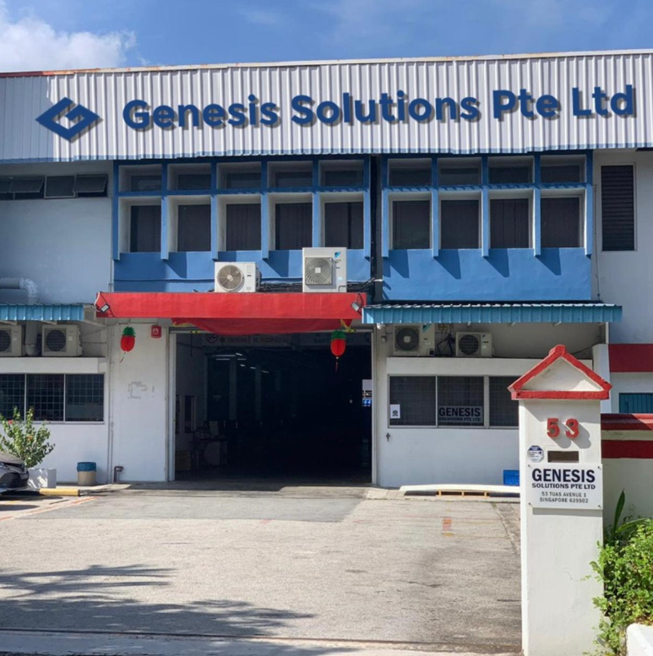
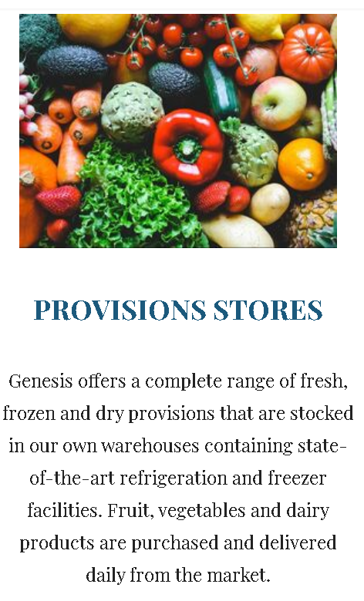
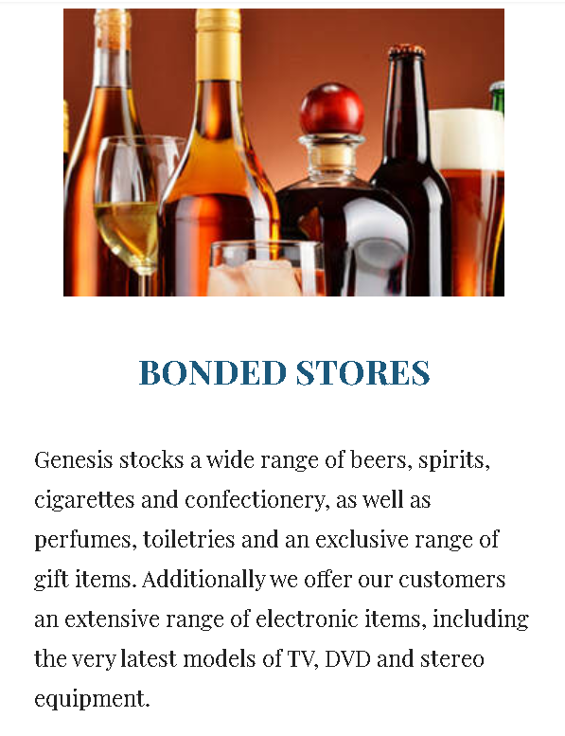
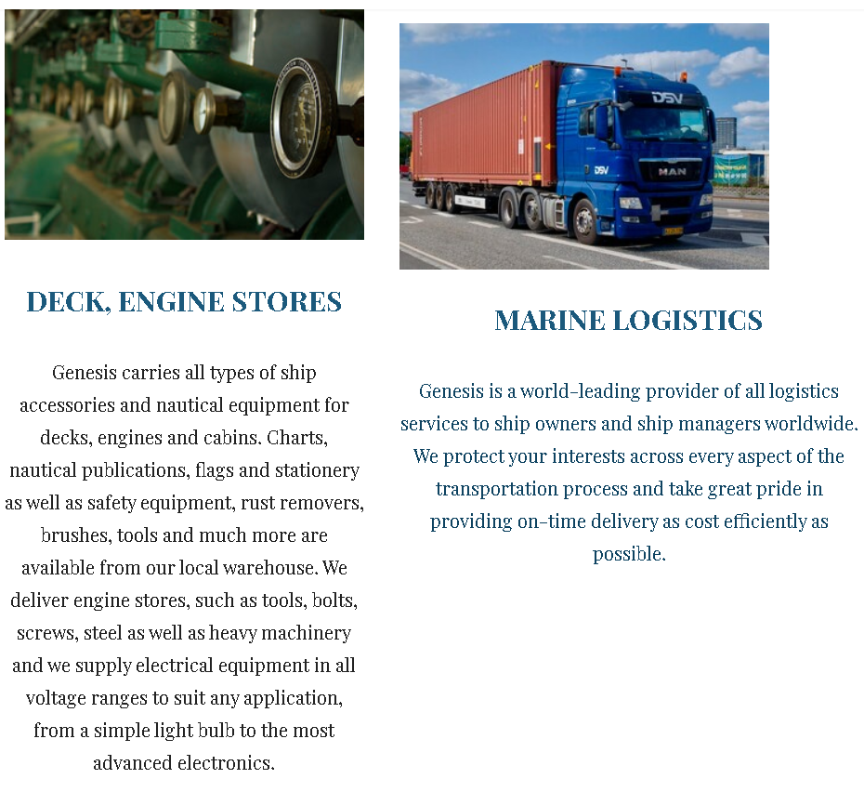
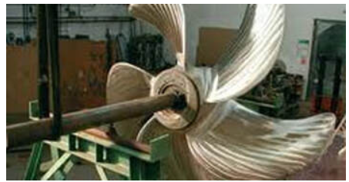
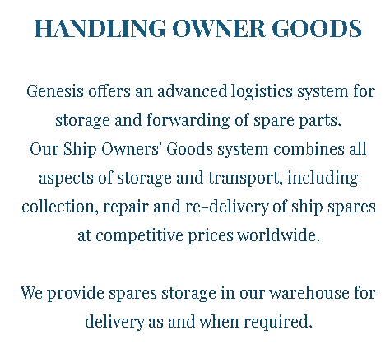
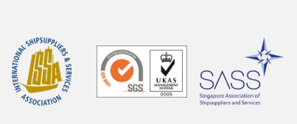

Slide 2



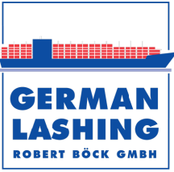
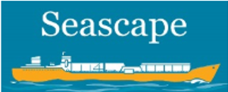

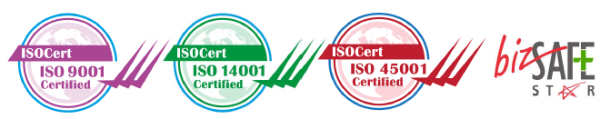
Genesis optimizes its service through adoption of the latest technology, using a combination of Artificial Intelligence, Machine Learning, IoTs and related hardware and software to enhance customer experience through the benefits of smart procurement and smart logistic. All company services are accompanied with a seamless and integrated 24/7/365 support.
At Genesis Solutions, its people are its most valuable asset. Genesis Solutions recognizes that the company is only as good as its people are. Therefore effective use of technology is coupled with knowledgeable and competent team members as well as a management team that has over 30 years experience in marine & offshore supply chain.
Genesis Solutions is ISO 9001:2015 certified, while working on becoming ISO 14001, ISO 22000 and OHSAS 18001 certified in the next 12 months.
Genesis Solutions currently operates out of a 2000 square meter supply chain center and carries over 1000 SKUs in stock. The plan is to increase it to 3000 SKUs so that customers will have round the clock support at all times. The company is now working on digitalizing the inventory to ensure that both quality and quantity meet customer expectations.
Genesis Solutions represents German Lashing, Filtec-Rixen and Power Research Inc and also manages their inventory & last mile delivery in Singapore.
The company’s mission is to be the partner of choice and not just a supplier of choice. Thus the company is investing on excellent service as a means to offer added value to the customer with the aim of maintaining long term client relationships.
visit Genesis website today at www.genesis.work for a better understanding of the company

Slide 3
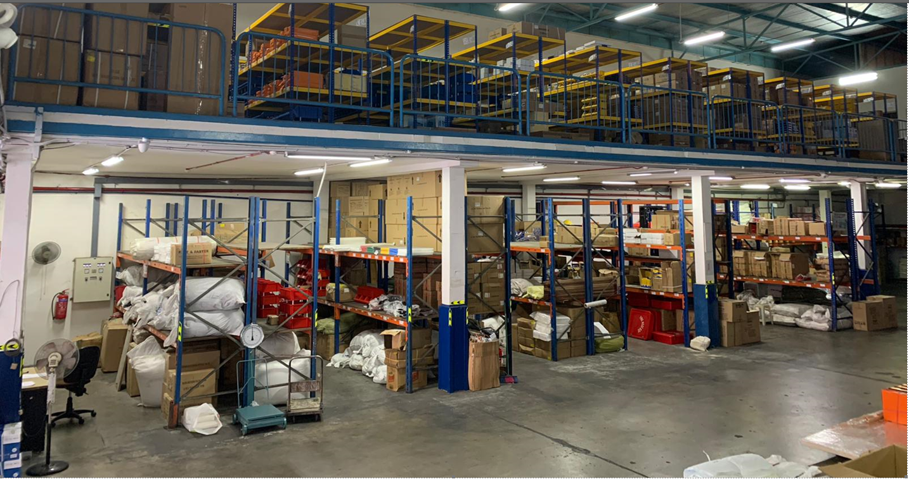
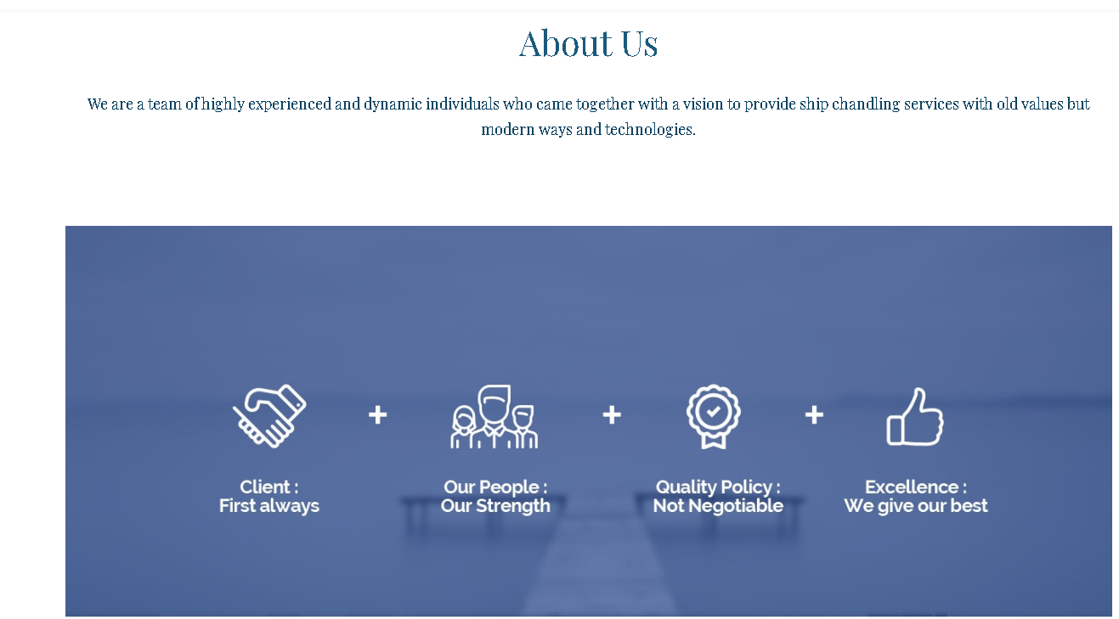
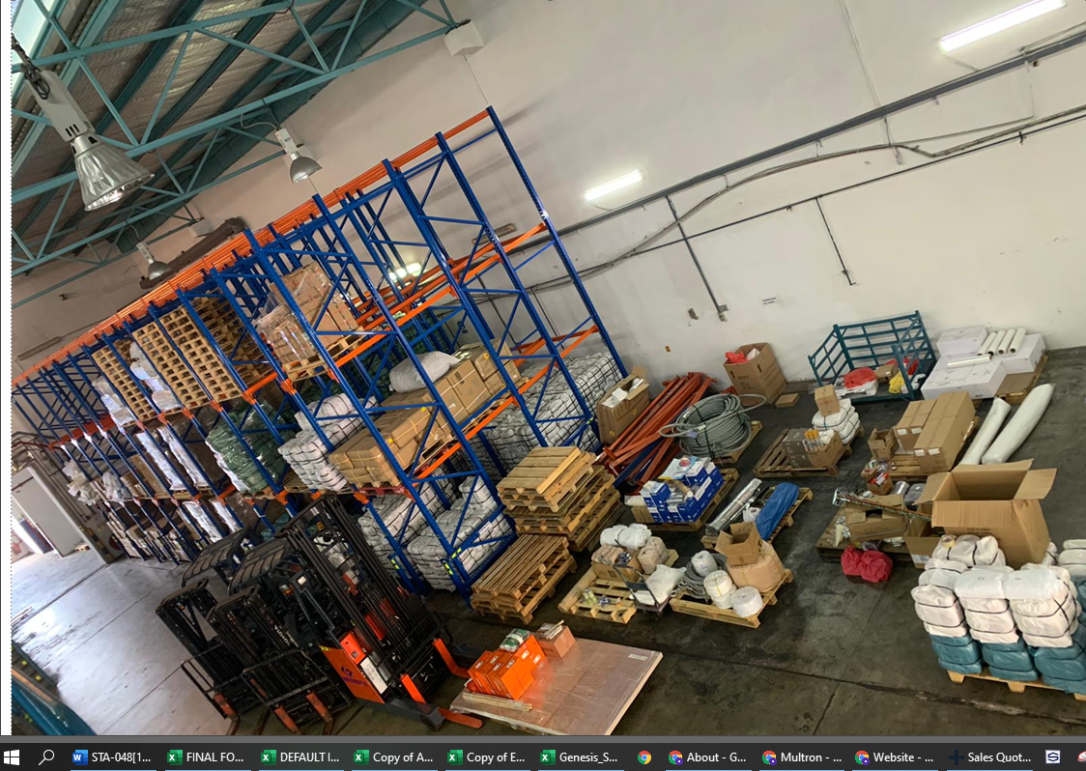

Slide 4
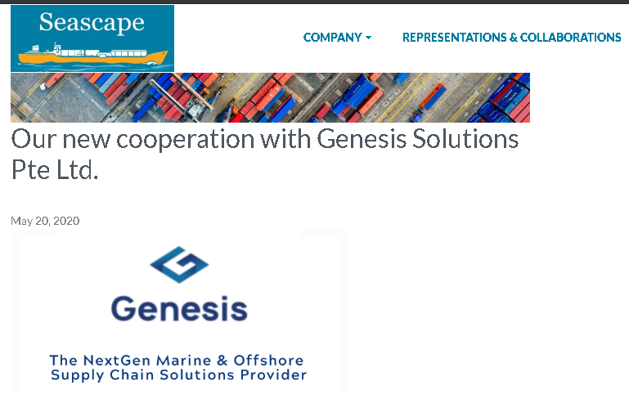
Our latest collaboration with SEASCAPE GREECE
STARTING FROM 2020

