Slide 1
State-of-the-art Condition Monitoring Solutions

Slide 2

Our Core Strengths
  500,000 Samples Analysed
  3000+ Vessels served
  50 Years of experience at Sea
  1 Goal: Performance Assured
Reliability
Simplicity
Technical Expertise
Pricing

Slide 3
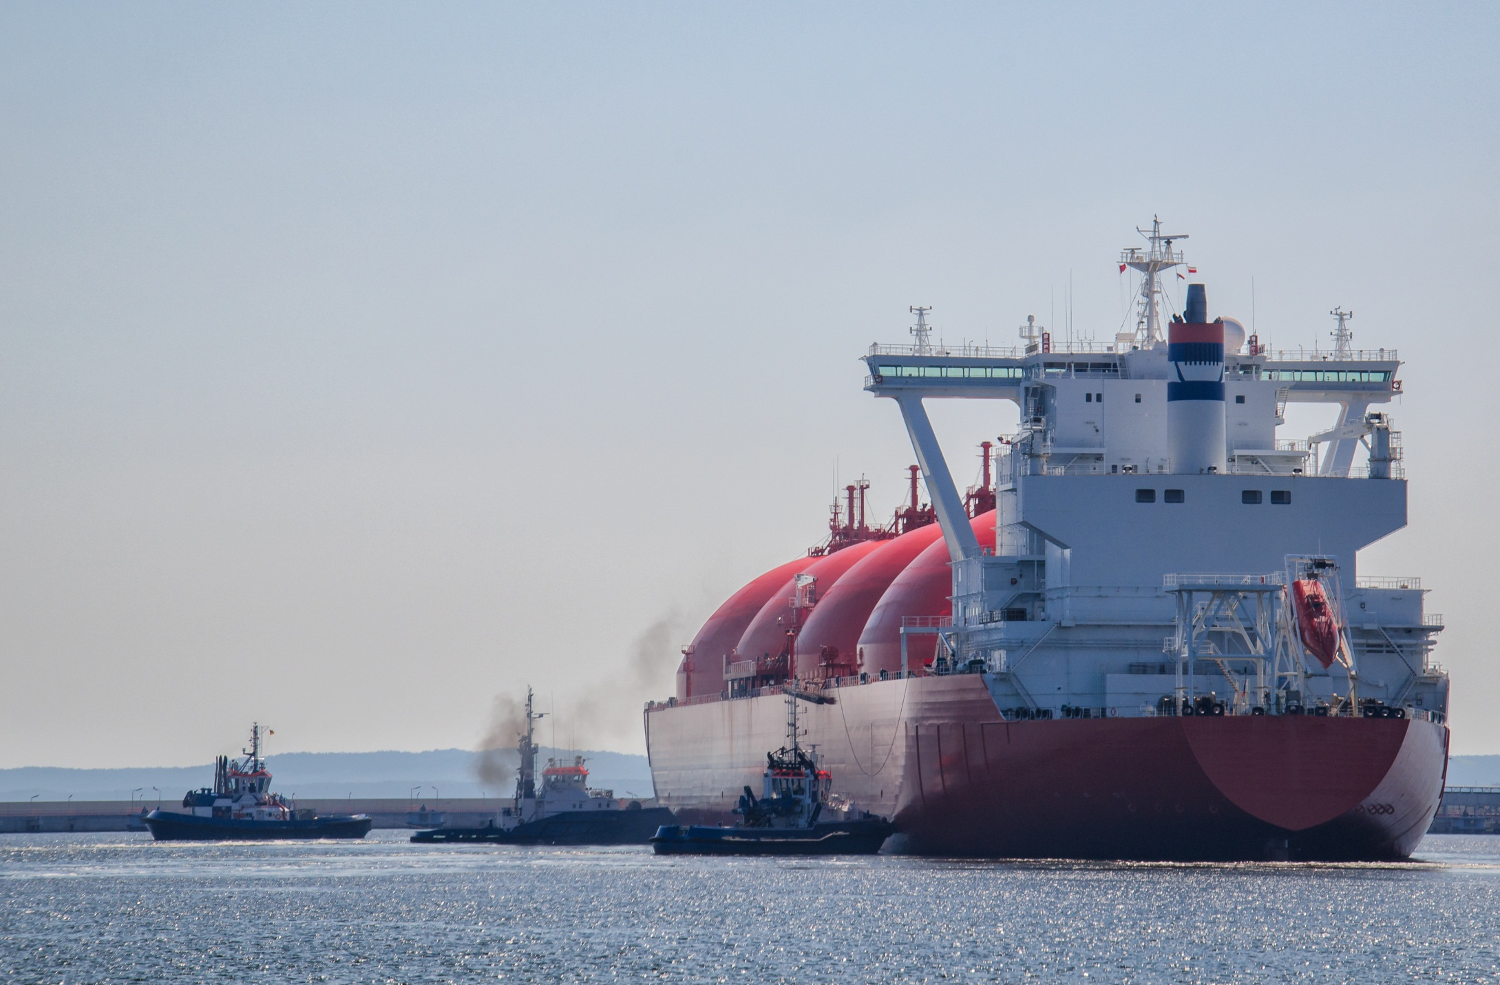
Key Figures
  More than 25% incidents at sea are caused by machinery failure
  60% of machinery failure occurs immediately after a maintenance activity
  40% of PSC detentions are related to machinery malfunctioning

Slide 4

Our Strengths
  Marine Engineering Expertise
  “Real Life” Diagnosis
  Up to Date On-board Experience
  Independent
  Globally Managed Logistics
  Expert Helpline

Slide 5
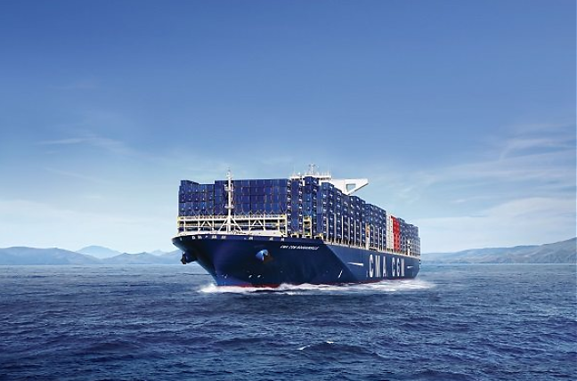
Our Mission
  Reduce Spend
  Reduce Downtime
  Reduce Risk
  Reduce Staff Workload
  Increase Supply Chain Efficiency
  Increase Asset Reliability
  Increase Decision-making Effectiveness
  Increase Operational Efficiency
  YOUR BENEFIT → your vessels operating in the market more safely, more efficiently and for longer, generating additional cash flow and ROI

Slide 6

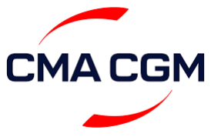



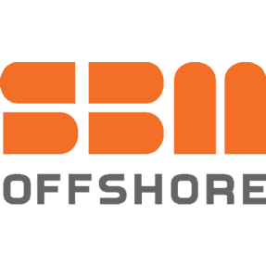











Who else shares our values…
Who Else Shares Our Values…

Slide 7

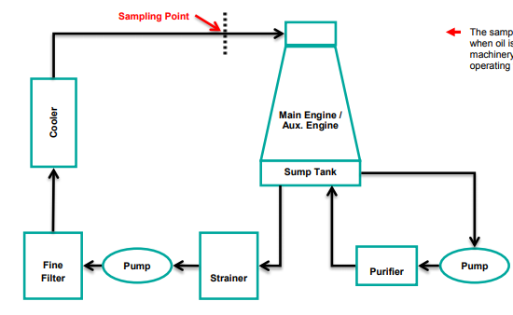
Who else shares our values…
Condition Monitoring Programmes
Lube Oil Analysis
  Machinery health snapshot
  Identify build-up of wear particles
  Identify sources of contamination that may cause machinery failures (e.g. HFO ingress → crankcase explosion)
  Identify problems with specific parts of the system that may trigger a fault (e.g. oil cleanliness → filters)
  Determine adequacy of current
  Lubrication (e.g. KV, BN, etc.)

Slide 8
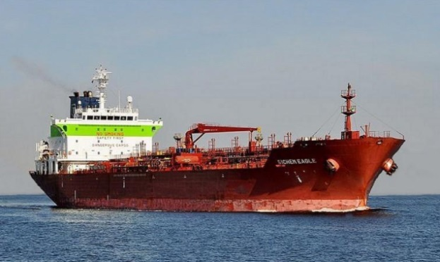
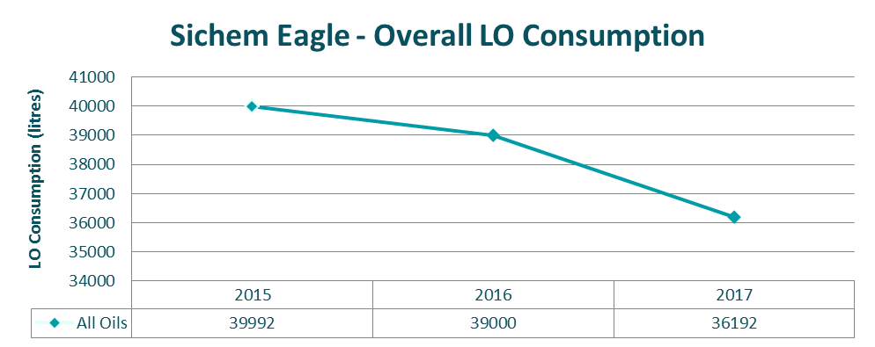

Condition Monitoring Programmes
Benefits of SeaTec Independent LO Analysis
  A recent study conducted on 756 vessels between 2015 and 2018, found that vessels that use SeaTec oil analysis – as opposed to a lube supplier analysis – consume on average 17% less oil. Savings are consistent across all ages, the most notable being achieved on ships aged 0-5 and >20. Some of the vessel types where the most notable savings were achieved were Tankers (-28%), Containers (-28%), Self Unloaders (-25%) and Gas Carriers (-60%)
  -56% Cylinder Oil
  -67% System Oil
  Up to -51% Auxiliary Engine Oil
  -45% Other Oils
  Tanker, Handy (32k DWT)
  DWT: 25421
  Year Built: 2008
  Year Switched to SeaTec: 2016
  Compounded Saving Achieved: -8%

Slide 9
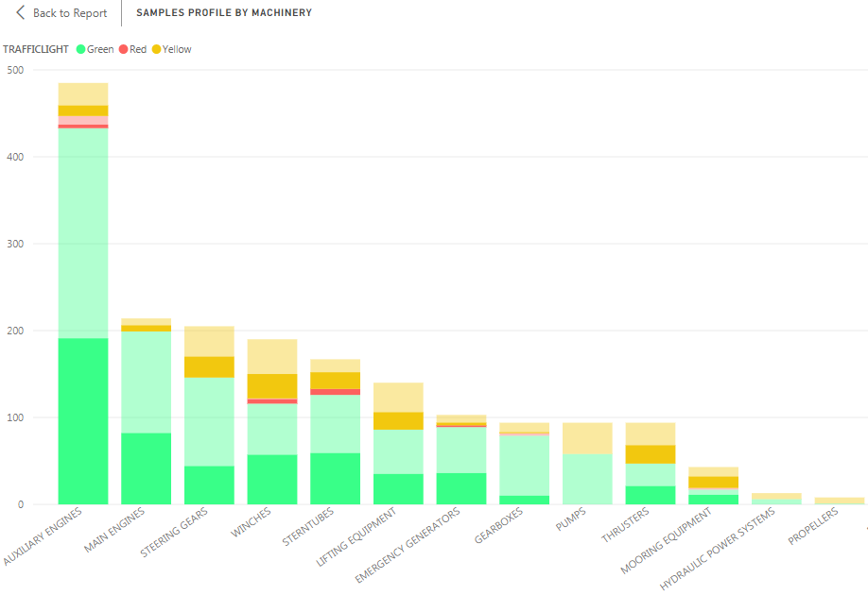

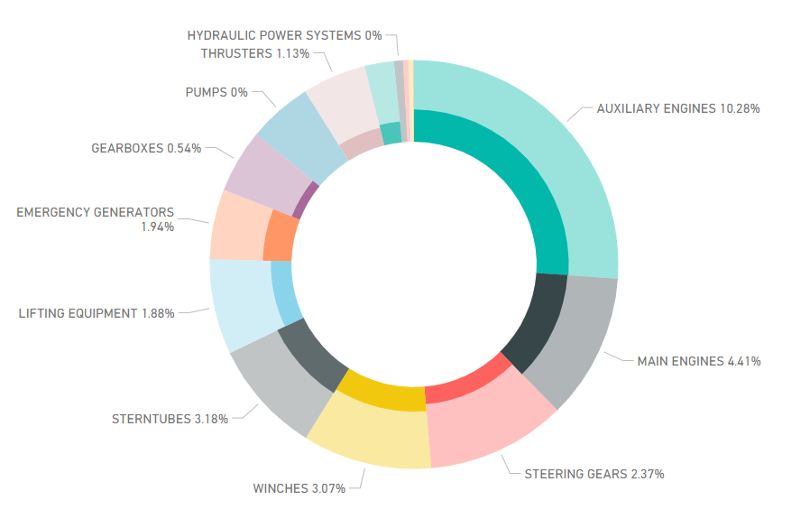
Advanced Bespoke Reporting

Slide 10
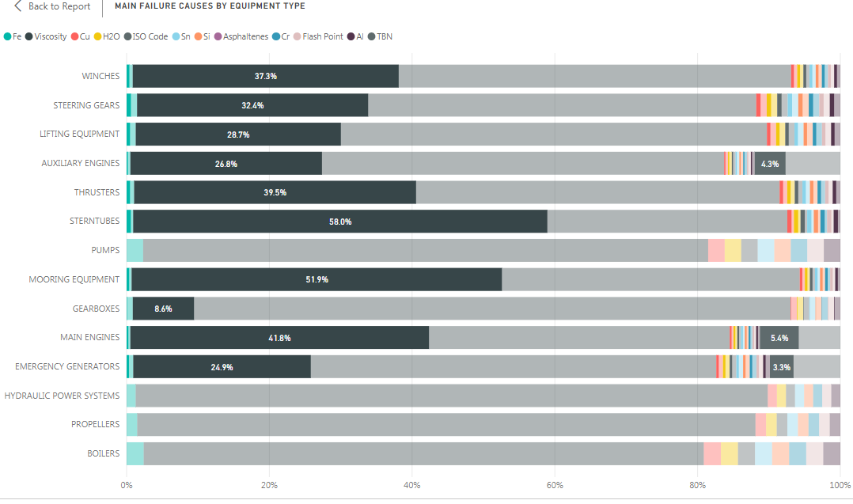
Advanced Bespoke Reporting

Slide 11
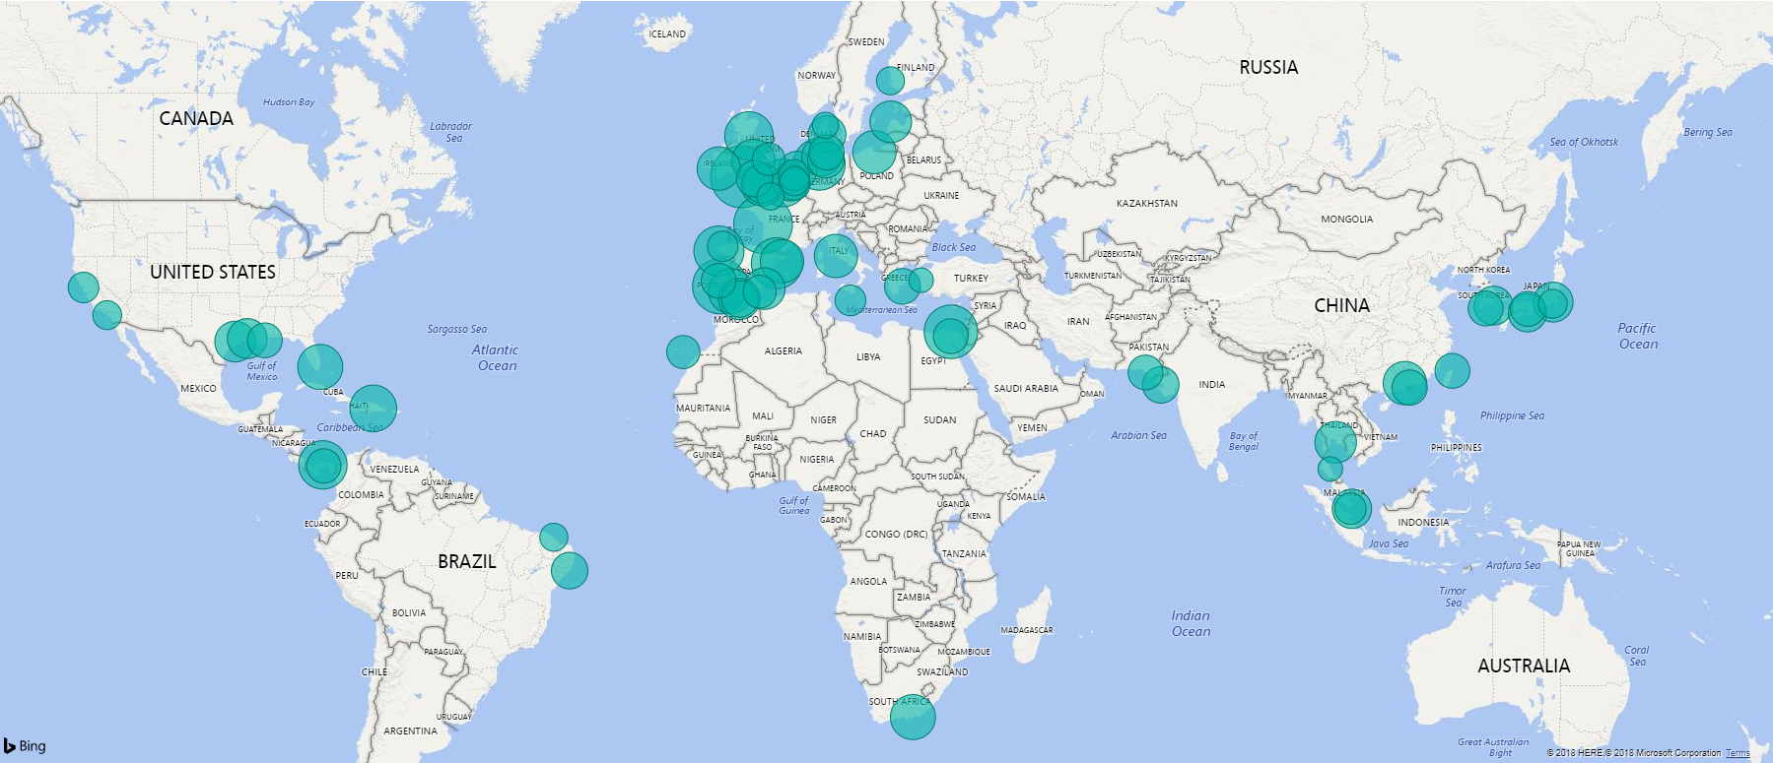
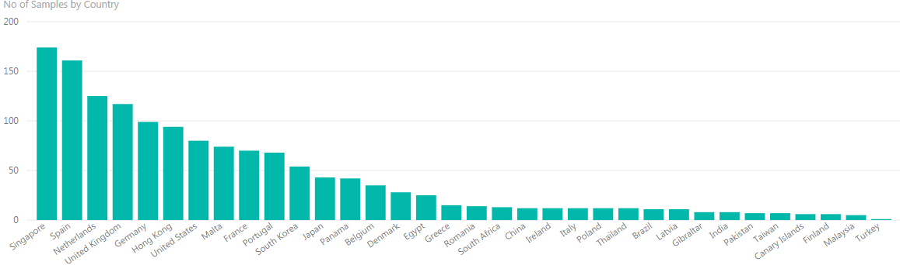

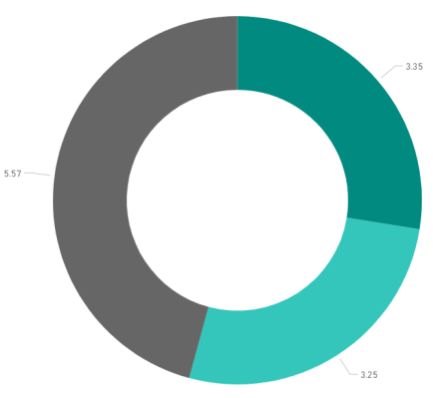

Constant KPIs monitoring
12.1

Slide 12

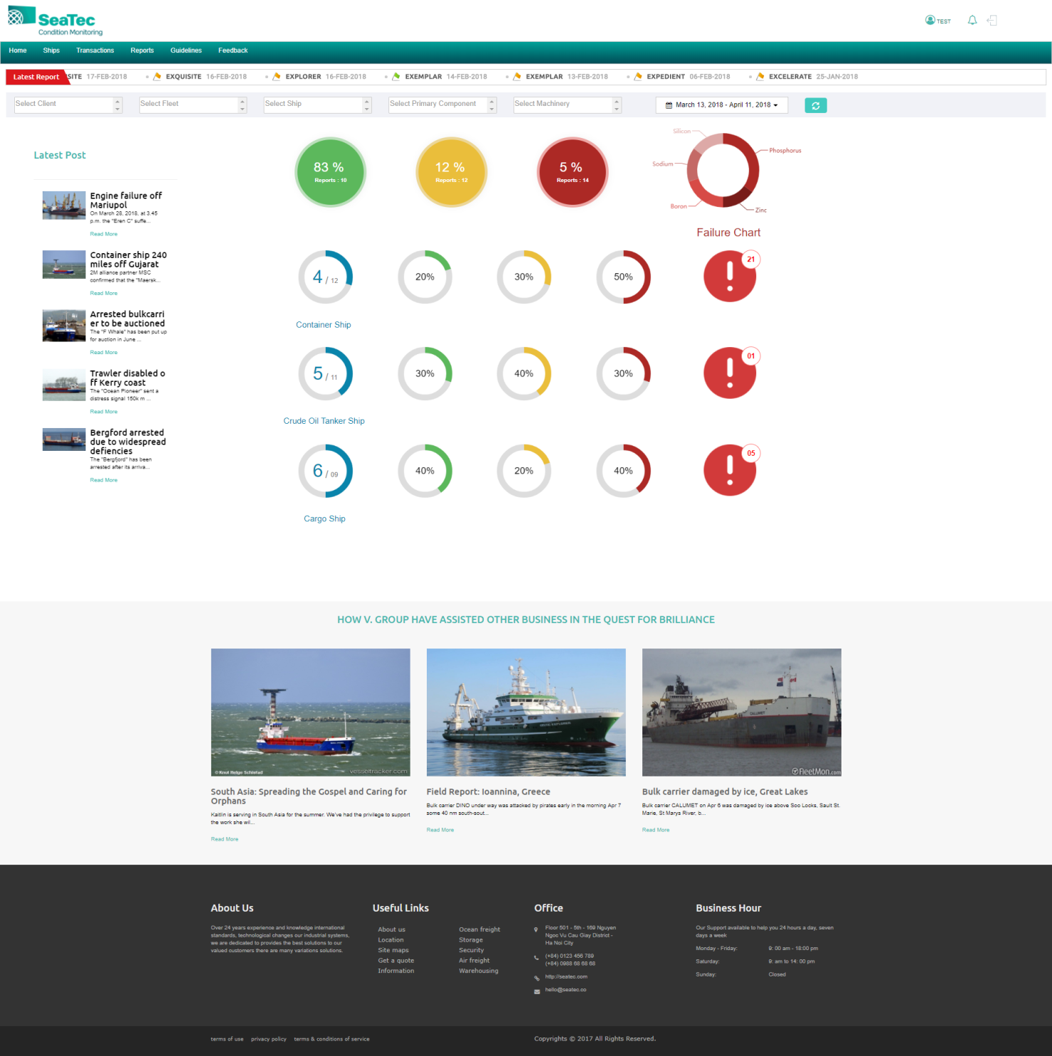
Online Cloud Database
Dashboard Interactive View
Report Delivery

Slide 13
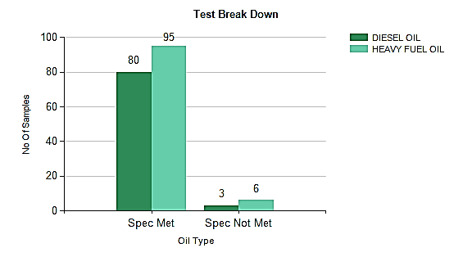
Advanced Bespoke Reporting
FO/MDO/MGO Analysis, Lubricity & Compatibility Test
Off-Spec Factor | No. of Samples
Density at 15°C | 1
Kinematic Viscosity at 50°C | 1
Pour Point | 2
Sodium | 1
Water | 4
Bunkers Test Breakdowns
Off-spec causes
Ports and Suppliers at Risk for Off-spec Bunkers

Slide 14
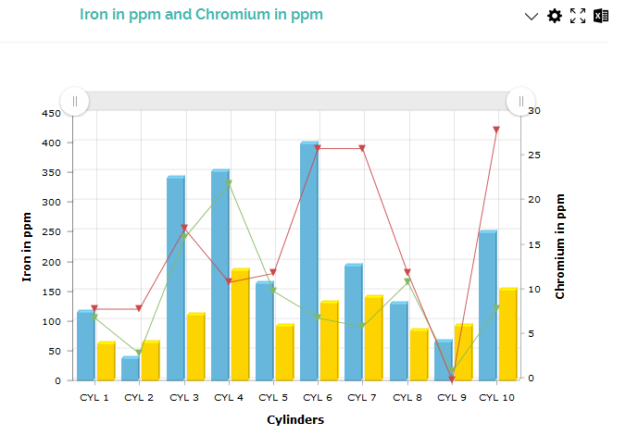
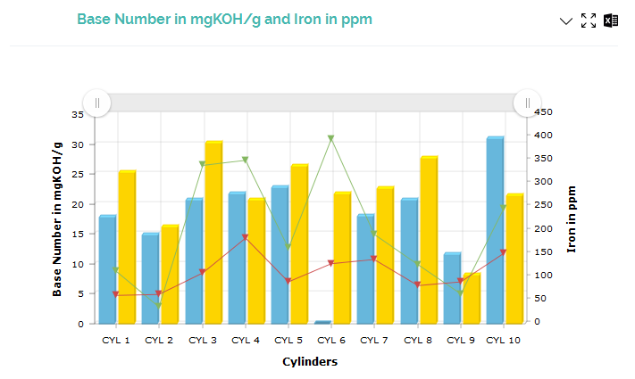
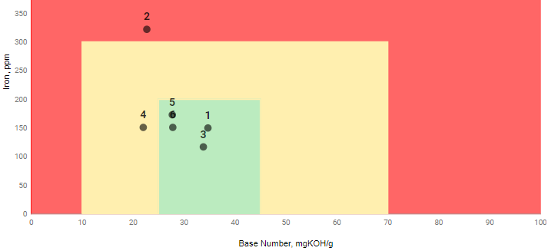
Performance Optimisation
Cylinder Scrape-down Oil Analysis – LO Consumption Optimisation
Optimise Cylinder Oil Feed Rate by
  Maintaining oil BN (alkalinity) within acceptable limits in order to neutralise H2SO4 and avoid corrosion
  Monitoring iron (wear) content in oil to ensure proper lubrication is maintained
Interactive cylinder analysis graphs: Multiple sample results can be compared against one another in various graphical formats to analyse cylinder health and prevailing trends.

Slide 15
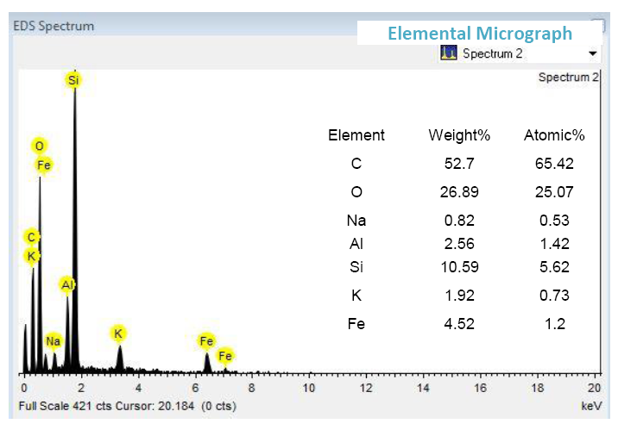
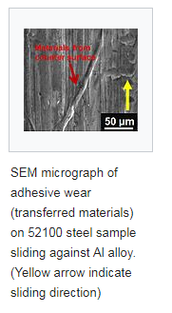
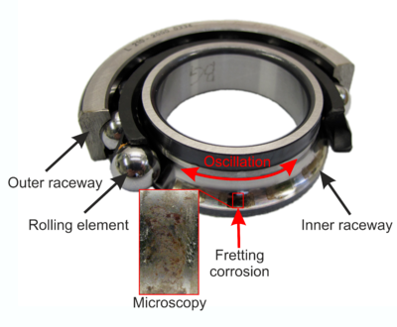
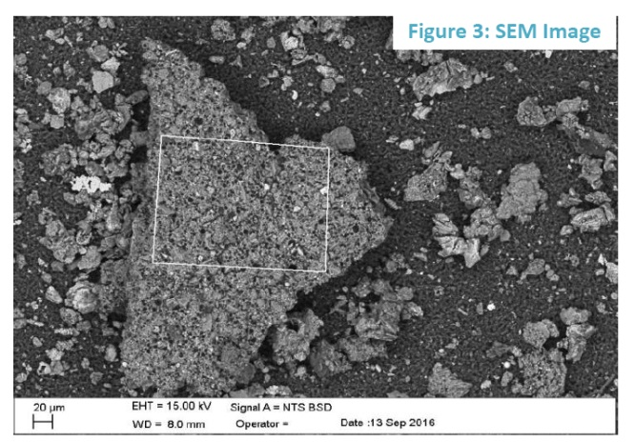
Advanced Analysis Capabilities
SEM & EDS
  Machinery health snapshot
  Identify the specific type of wear in the elements detected (e.g. abrasive, adhesive, surface fatigue, galling)
  Identify the specific component suffering damage in order to carry out localised overhauls

Slide 16

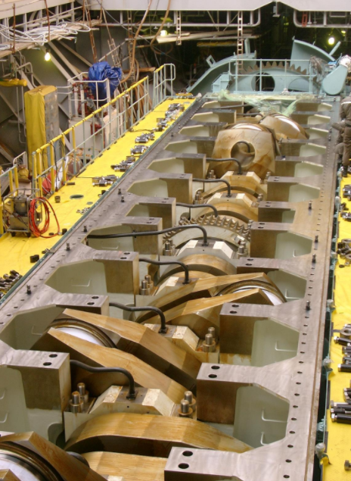


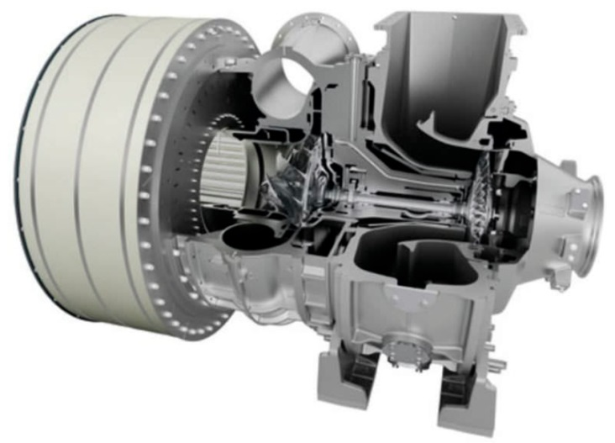
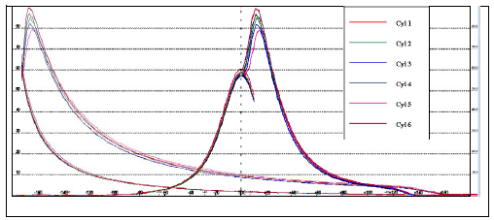
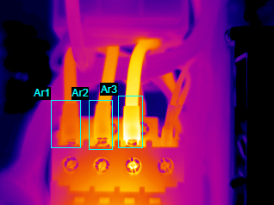
Bespoke Surveys
Optimise machinery performance, reduce energy dissipation, decrease consumption, prevent breakdowns, avoid costly overhauls
Improved HSE for crew through detection of exhaust gas leaks, prevent electrical short-circuits, prevent breakdowns, prevent fire on-board.
Optimise engine and generators’ performance, reduce consumption, reduce NOx, SOx and PM emissions ensuring compliance with IMO 2020, extended engine and components’ lifetime via improved combustion

Slide 17
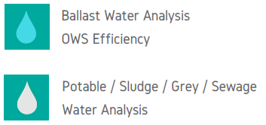
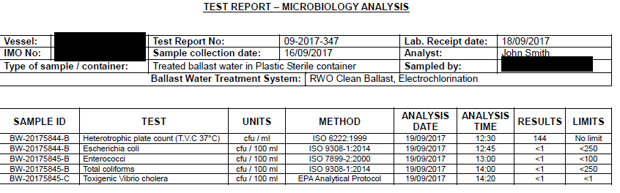
Mandatory Requirements
Some types of analyses are to be executed due to mandatory requirements set out by either international or local administrations. Some examples are as follows:
Ballast Water Analysis – Required 2x year for commissioned working BWTSs as per VGP 2013
Potable / Sewage Water Analysis – Required 1x year as per MLC 2006 as amended on 2013
OWS Efficiency – Required 1x year as per MARPOL MEPC 107 (49)

Slide 18


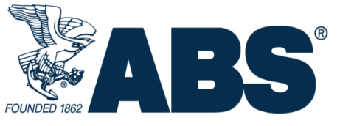
Quality Assurance
SeaTec Management System – ISO 9001 LR, UKAS
Partner Laboratories – ISO 17025
Class Approval – Lloyd’s Register, American Bureau of Shipping

Slide 19
Features & Benefits
Feature | Advantage | Benefit | Increase | Reduce | Proof
LO Analysis | Independent | No link to lube oil suppliers, enabling you to maximise the lifetime of your lubes and reduce spend | Lube lifetime Increases purchasing flexibility | Spend on lubricants Dependency on a single lube oil supplier | One of our customers achieved a $2.3M over 3 years after switching to SeaTec, owing to improved machinery performance and reduced lubricant consumption
All Products | Dedicated and specialised team of tribologists, senior marine and chief engineers | Detailed diagnostics done by subject matter experts, based on actual seagoing experience and thorough understanding of the problems being faced on-board. | Staff efficiency Decision-making effectiveness Quality of reporting | Time to analyse reports | Thanks to our marine engineers’ expert diagnostics, SeaTec was able to spot a leak within the injectors of an emergency generator that could have prevented correct start of the engine, resulting in a PSC detention.
All Products | Web/App Platform | All your data, including reports and trends, is easily accessible and available to provide an audit trail. Detailed KPIs are available not only for your vessels and suppliers, but also for SeaTec themselves, to measure how well we are performing. | Ease of data accessibility Staff efficiency | Risk of misplacing reports and documentation Risk of observations/non-conformities | During an oil major vetting inspection, the accessibility to our mobile app was key as the copies of the lube and bunker reports had been misplaced, with the potential to result in a NC. The Superintendent, however, used SeaTec mobile app to provide the auditor with all the documentation needed and no observation was noted during the audit.
LO Analysis | Accepting any oil brand | All your data is analysed and stored on our platform, regardless of the oil supplier, allowing you to negotiate the best rates for the supply of lube oil or purchase directly from the spot market. | Database and statistical analysis capability Purchasing agility Purchasing power | Lub oil spend | Business intelligence research has shown that the analysis done by the oil suppliers accounts for ~ $3/100l. By removing this additional hidden cost, you can achieve a further reduction on your lube oil spend. Furthermore, having an independent analysis supplier will give you the flexibility to switch supplier any time you want.
LO/FO Analysis | Periodic Reports | Our bespoke periodic reports provide you with insights of your vessels machinery performance, SeaTec reporting and lead times, statistics of ports and suppliers quality, enabling you to maximise the effectiveness of your decision-making process and improve your supply chain efficiency. | Effectiveness of your decision-making process Supply chain efficiency | Staff workload Decision-making time | All of our clients can now make informed decisions based on the quality of the fuels, avoiding “risky” suppliers. They can also see the trend of their key machinery performances and select the best ports to dispatch their samples so as to achieve the minimum turnaround time and get their reports quicker. Clients have used the findings in order to justify additional capex spend on filtration systems.
All Products | Expert helpline | You enjoy a direct helpline with a dedicated team of experts that are available to answer to your queries and walk you through the reports. They operate on a 16 hour window, 6 days per week, in order to be available at virtually all times. | Staff efficiency Easiness of communication | Staff workload | Our team of tribologists liaise with our clients on a daily basis to get updates on vessels’ operation and other key parameters, enabling for a greater accuracy in the reports.
All Products | Free re-testing | If one or more parameters in your samples are off-spec, we will ask the lab to re-test. This is done at no extra cost for you and allows us to make sure that the chemical results are correct before we issue the report. This means to you that you’ll only have to make decisions on 100% facts, without guessing. | Certainty of the analysis result Effectiveness of your decision-making process Staff efficiency | Risk Lube oil spend Sample re-testing cost Staff workload | One of our clients has recently saved $35k by maintaining the same oil in operation. The initial analysis suggested an high content of wear material, however, further to retesting, it was noted that this was due to the contamination of a specific sample and no oil change was needed.
All Products | Globally managed logistics | Thanks to our contract with DHL we take care of your logistics worldwide. We will dispatch our kits to any vessel, anywhere in the world, and your vessels can return the samples from anywhere. | Staff efficiency | Turnaround time Logistics costs Unexpected delays | One of our new major clients recently praised the benefits of SeaTec’s logistics management, highlighting how the numbers of samples lost in transit or being held for long periods of time by the customs has been eliminated.

Slide 20

Reliability. Availability. Safety.
  Questions
  Gabriele Dadò – Commercial Manager
  E: gabriele.dado@seatec-services.com

